Slide 1
Unit-2 UNIX Operating System Internals
Evolution, Architecture, Process Management, File System, Memory Management, and Performance Optimization

Slide 2
Evolution & Architecture of UNIX
• Why UNIX? Multi-user, multitasking, portability
• History & Evolution Timeline: 1969 → Multics → UNIX V6 → BSD → System V → Linux
• Design Philosophy: Do one thing well, small programs, pipes & filters
• Architecture: User Mode & Kernel Mode
• Kernel Components: Process, File System, Memory, Device Drivers
• System Calls & Shell as interface

Slide 3
Why UNIX?
1. Multi-user
Multiple users can log in and work simultaneously.
Resources (CPU, memory, disk) are shared efficiently among users.
Example: On a server, one user may run a database, other edits files, while another compiles code — all at the same time.
2. Multitasking
UNIX allows many processes to run concurrently.
Background jobs (&), scheduling, and signals help manage multiple tasks.
Example: You can download files, edit text, and run a simulation all together without one stopping the other.
3. Portability
Written mostly in C language (after early assembly versions).
Easy to recompile and run on different hardware architectures.
Example: The same UNIX-like commands work on IBM servers, Macs, and Linux PCs.

Slide 4
History & Evolution Timeline of UNIX
1960s – Origins
Multics (1964–1969) → joint project by MIT, Bell Labs, and GE.
Too complex and costly, so Bell Labs withdrew.
Inspired a simpler OS → UNIX.
1969 – Birth of UNIX
Created by Ken Thompson & Dennis Ritchie at Bell Labs.
Initially written in assembly, later rewritten in C language (1973).
This made UNIX portable across machines.
1970s – Early Versions
UNIX Version 6 (1975): widely distributed to universities.
Helped researchers and students, leading to innovation.
1977 – BSD (Berkeley Software Distribution)
Developed at UC Berkeley.
Introduced C shell, TCP/IP networking, and other advanced features.
1983 – System V (AT&T)
Commercial branch of UNIX.
Added System V IPC, init system, shared libraries.
1991 – Linux
Linus Torvalds created Linux kernel, an open-source UNIX-like system.
Combined with GNU tools → GNU/Linux OS.
Today, Linux powers servers, Android, supercomputers, cloud systems.

Slide 5
UNIX Design Philosophy
1. Do One Thing Well
Each program is designed to perform a single task efficiently.
Example:
grep → searches text.
sort → sorts text.
wc → counts words/lines.
Instead of one big “do-everything” tool, UNIX uses small, focused tools.
2.Small, Simple Programs
Programs should be short, modular, and easy to debug.
Example: Instead of a huge text editor, UNIX provides:
cat → view files.
vi → edit files.
more/less → view files page by page.

Slide 6
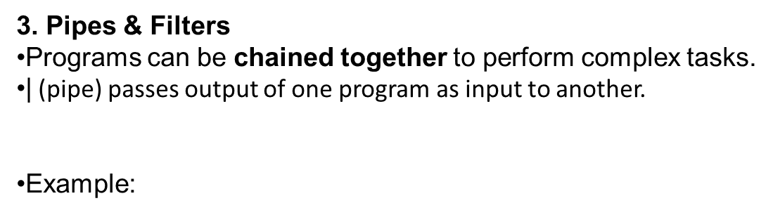
cat file.txt | grep "error" | sort | uniq -c
cat → reads file.
grep "error" → filters only lines with “error”.
sort → sorts them.
uniq -c → counts duplicates.
Together → powerful data processing in one line.

Slide 7
User Mode & Kernel Mode
1. User Mode
Where applications and user programs run.
Examples: ls, cat, gcc, browsers, editors.
Programs can’t directly access hardware → they must use system calls to request services from the kernel.
2. Kernel Mode
The core of the operating system.
Has full access to CPU, memory, and hardware.
Manages:
Process management (scheduling, signals)
Memory management (paging, swapping)
File system (inodes, file operations)
Device management (drivers, I/O handling)

Slide 8
System Call Interface
Bridge between User Mode and Kernel Mode.
Example:
User runs open("file.txt") → goes to kernel.
Kernel checks permissions, allocates resources.
Returns file descriptor back to user program.
User Space | Applications (ls, vi) Shell (bash, sh, csh)
System Calls
Kernel Space | Process Management File System Management Memory Management Device Drivers
Hardware Layer

Slide 9
Kernel Components in UNIX
1. Process Management
Creates, schedules, and terminates processes.
Handles context switching, signals, and inter-process communication (IPC).
Ensures fair CPU allocation among multiple users/processes.
Example: The fork() and exec() system calls.
2. File System Management
Manages files and directories using inodes.
Provides a hierarchical tree structure for files.
Supports permissions, links, mounting, and device files.
System calls: open(), read(), write(), stat().

Slide 10
Kernel Components in UNIX
3. Memory Management
Allocates and deallocates memory for processes.
Implements virtual memory with paging and swapping.
Prevents one process from interfering with another’s memory.
Example: malloc() in user programs, handled internally by kernel memory managers.
4. Device Drivers
Kernel modules that let the OS communicate with hardware.
Provide a uniform interface so programs don’t worry about device details.
Types: character drivers (keyboard, serial port), block drivers (disk), network drivers.
Example: When you read a file from disk, the request goes through the file system → device driver → disk hardware.
User Space
System Calls
Kernel Space | Process Management File System Management Memory Management Device Drivers
Hardware

Slide 11
System Calls & Shell as Interface
System Calls
Definition: Special functions provided by the kernel that allow user programs to request OS services.
They are the only way user programs can interact with kernel functions (since direct hardware access is not allowed in user mode).
Categories:
Process Control → fork(), exec(), exit()
File Management → open(), read(), write(), close()
Device Management → ioctl(), read(), write()
Information Maintenance → getpid(), alarm(), time()
Communication → pipe(), shmget(), msgsnd()
example
int fd = open("file.txt", O_RDONLY); // System call
read(fd, buf, sizeof(buf)); // System call
close(fd); // System call

Slide 12
2. Shell
A command-line interpreter that acts as the user interface to the UNIX system.
It accepts commands from users, interprets them, and makes the appropriate system calls to the kernel.
Types of shells:
sh (Bourne shell)
csh (C shell)
bash (Bourne Again shell, most common)
Example flow:
User types: ls -l
Shell translates into system calls: opendir(), readdir(), stat()
Kernel executes, returns output to user.

Slide 13
3. User → Shell → Kernel → Hardware
User
commands
Shell
interface
System call
Kernel
Hardware

Slide 14
Process Management in UNIX
• Process definition, attributes, PCB
• Process States: New, Ready, Running, Waiting, Terminated
• Parent & Child Relationship
• fork() system call – process creation
• exec() family – replacing process image
• Orphan & Zombie processes
• Signals – SIGKILL, SIGINT, SIGCHLD
• Signal Handling in C (signal() function)
• Job Control: &, fg, bg, kill

Slide 15
Process Definition
A process is a program in execution.
It is more than just the program code (text section); it also includes:
Current activity represented by the program counter (PC)
Processor registers
Process stack (temporary data like function parameters, return addresses, local variables)
Data section (global variables)
Heap (dynamically allocated memory)
In simple terms: Program = Passive entity (file on disk), Process = Active entity (running program + resources).

Slide 16
Process Attributes
Each process has several attributes that define its current state and identity:
Process ID (PID): Unique identifier for each process.
Process State: Current state (New, Ready, Running, Waiting, Terminated).
Program Counter: Address of the next instruction to be executed.
CPU Registers: General-purpose registers, accumulator, stack pointers, etc.
Memory Management Info: Base and limit registers, page tables, segment tables.
Scheduling Info: Priority, scheduling queues, CPU burst time.
Accounting Info: CPU usage, real time used, job or process numbers.
I/O Status Info: List of open files, I/O devices allocated, pending I/O requests.
Parent Process ID: To maintain parent-child relationship.
Privileges: User ID, group ID, access rights for resources.

Slide 17
Process Control Block (PCB)
The PCB is a data structure maintained by the operating system for every process.
It contains all the information needed to manage and control the process.
The PCB acts as the "identity card" of a process.
Contents of PCB
1.Process Identification Process ID (PID) Parent process ID User ID, group ID | 4.Memory Management Information Base and limit registers Page tables / segment tables
2.Process State Information Current state (Running, Ready, Waiting, etc.) Program counter CPU registers Stack pointer | 5.Accounting Information CPU usage, execution time, job number Time limits, job queue position
3.CPU Scheduling Information Process priority Scheduling queue pointers CPU burst time, quantum | 6.I/O Information List of open files Devices allocated Pending I/O requests

Slide 18

Process States
New → process creation
Ready → waiting for CPU
Running → executing on CPU
Waiting → waiting for I/O/event
Terminated → process finished

Slide 19
Process States
New (Creation State) Process is being created. OS is allocating resources: Memory space PCB initialization File descriptors If resources are available and admission policy allows, the process is moved to Ready state. If not, process may be rejected. | Waiting (or Blocked State) Process cannot continue execution until an external event occurs. Common reasons: I/O request (disk read, network access) Waiting for a resource (like a printer) Waiting for a signal from another process Once the event is complete, the process moves to the Ready Queue.
Ready (Waiting for CPU) The process is in main memory and is waiting for the CPU scheduler. It is ready to run, but not currently executing because the CPU is busy. Multiple processes can exist in the Ready Queue. | Terminated (Exit State) Process has finished execution (successfully or abnormally). OS deallocates all resources: Memory Open files I/O devices PCB may be kept temporarily for statistics or debugging. 📌 Example: You close a text editor after saving your file → the process is terminated.
Running (Execution State) Process is executing instructions on the CPU. Program Counter (PC) indicates the next instruction. Only one process per CPU/core can be in Running state. A process may leave the Running state in three ways: Voluntary yield → waiting for I/O (goes to Waiting). Preemption → scheduler stops it to give CPU to another process (goes to Ready). Completion → finishes execution (goes to Terminated).

Slide 20
1. Process Creation
A new process is created using the fork() system call.
The parent process calls fork().
fork() creates a nearly identical child process.
Both processes continue execution independently from the point where fork() was called.
Every Process Has a Parent
Except for the very first process (init or nowadays systemd), all processes are created by other processes.
When a process creates another using fork(), it becomes the parent, and the new one is the child.
Each process has:
PID (Process ID)
PPID (Parent Process ID)

Slide 21
How fork() Works
When a process calls fork():
The parent process continues execution after the fork.
The child process starts execution as a copy of the parent (same code, same variables, same program counter).
But they are independent: changing a variable in the child does not affect the parent
pid_t pid = fork();
if (pid == 0) {
// Child process
printf("I am the child! My PID = %d, My PPID = %d\n", getpid(), getppid());
}
else
{
// Parent process
printf("I am the parent! My PID = %d, My child's PID = %d\n", getpid(), pid);
}

Slide 22
2. Parent–Child Relationship
Parent Process: The process that initiates the creation of another process using fork().
Child Process: The newly created process.
The child inherits many attributes from its parent:
Process environment (variables, open file descriptors, working directory, etc.).
User IDs and group IDs.
Priority and scheduling parameters.
But, the child gets:
A unique Process ID (PID).
Its own copy of data, stack, and heap segments (not shared unless explicitly done with shared memory).

Slide 23
3. Execution After Fork
After fork(), two processes run concurrently:
The parent process receives the child’s PID as the return value of fork().
The child process receives 0 as the return value of fork().
This helps them decide what to do next.
4. Role of exec()
Often, the child process immediately calls one of the exec() family of system calls to replace its memory image with a new program.
Example: When you run a command in the shell:
The shell (parent) uses fork() to create a new process.
The child process uses exec() to load and run the command.
Parent (shell) waits for child to finish.

Slide 24
5. Process Termination & Orphans
When a child finishes execution, it sends a SIGCHLD signal to the parent.
The parent can collect the child’s exit status using wait() or waitpid().
If the parent terminates before the child:
The child becomes an orphan process.
The init (PID 1) adopts the orphan process, ensuring proper cleanup.
6. Zombie Processes
If the child terminates but the parent does not call wait():
The child remains in the process table with status “zombie” until the parent collects its exit status.
7. Example: Shell as Parent
When you type a command in the UNIX shell:
The shell (parent) calls fork().
The child process runs exec(command).
The parent may either:
Wait (foreground execution), or
Continue immediately (background execution with &).

Slide 25
Special Cases
Orphan Process
If the parent dies before the child finishes.
The child is “adopted” by init (PID 1).
Example:
Run a program in the background.
Kill the shell → The background job becomes an orphan.
Zombie Process
If the child dies but the parent never calls wait().
Child stays in the process table with status Z.
Takes up a slot in the table → bad for system health.

Slide 26
Signals in UNIX
A signal is a software interrupt delivered to a process. It notifies the process that an event has occurred (like pressing Ctrl+C, a child process ending, etc.).
Common Signals
SIGKILL (9)
Immediately kills a process.
Cannot be caught, blocked, or ignored.
Example: kill -9 <pid>
SIGINT (2)
Interrupt signal, usually sent when you press Ctrl+C in the terminal.
By default, it terminates the process, but you can catch/handle it in C.
SIGCHLD (17 or 20 depending on system)
Sent by the kernel to a parent when a child process terminates or stops.
Parent can handle it to call wait() or waitpid() to clean up the child.
Prevents zombie processes.

Slide 27
Signal Handling in C
We can write custom actions for signals using the signal() function.
#include <signal.h>
void handler(int signum); // custom function
signal(int signum, handler);
#include <stdio.h>
#include <signal.h>
#include <unistd.h>
void sigint_handler(int sig) {
printf("\nCaught SIGINT (Ctrl+C). Ignoring...\n");
}
int main() {
signal(SIGINT, sigint_handler); // Register handler
while (1) {
printf("Running... Press Ctrl+C to test\n");
sleep(2);
}
return 0;
}

Slide 28
3. Job Control in UNIX Shell
Job control allows users to manage foreground and background jobs.
Commands:
& (ampersand)
Run a process in the background.
Example:
sleep 100 &
Runs sleep in the background → shell prompt is free.
fg
Brings a background job to the foreground
bg
Resume a suspended job in the background.
Example:
Run sleep 100 then press Ctrl+Z → suspends it.
Run bg %1 → continues in background.
kill
Send signals to processes.
Example:
kill -SIGINT <pid> # send SIGINT
kill -9 <pid> # send SIGKILL

Slide 29
Summary
SIGKILL: immediate kill, no handling possible.
SIGINT: interrupt (Ctrl+C), can be caught with signal().
SIGCHLD: sent to parent when child terminates, useful to prevent zombies.
Signal handling in C: use signal() to define custom behavior.
Job control:
& → run in background
fg → bring to foreground
bg → continue job in background
kill → send signals to jobs

Slide 30
UNIX File System Internals
• File Types: regular, directory, device, pipe, socket
• File System Structure: boot block, superblock, inode table, data blocks
• Inode: metadata (owner, permissions, timestamps, pointers)
• Directory Implementation: names → inodes
• System Calls: open(), read(), write(), close(), stat()
• Hard vs Soft Links

Slide 31
File Types in UNIX
UNIX treats everything as a file – devices, sockets, directories, pipes.
File Type Details
Regular File
Contains actual data (text, binary, executable).
Can be read or written.
Example: /home/user/file.txt.
Directory File
A special file storing mappings of names → inode numbers.
Example: ls -l /home lists contents of a directory.
Device Files (found in /dev)
Provide access to hardware as files.
Character device: byte-oriented, sequential I/O (keyboard, serial port).
Block device: block-oriented, random access (hard disk).
Example: /dev/sda (disk), /dev/tty (terminal).
Pipe (FIFO)
Temporary files for Interprocess Communication (IPC).
Unidirectional data flow.
Socket
Allows bidirectional communication between processes (local or network).
Example: A web server listens on a socket at port 80.

Slide 32
File System Structure
A disk is divided into blocks. The UNIX file system (UFS/EXT) organizes it as
Boot Block --> Bootstrapping info
Superblock --> Filesystem metadata
Inode Table --> Metadata
Data Blocks --> Actual file contents
Components
Boot Block:
Located at the start of the partition.
Holds code to boot the system.
Superblock:
Global info about filesystem:
Size of filesystem
No. of inodes
No. of blocks
Free space map
Inode Table:
Array of inodes. Each inode describes one file.
Data Blocks:
Store actual file content (text, program code, etc.).

Slide 33
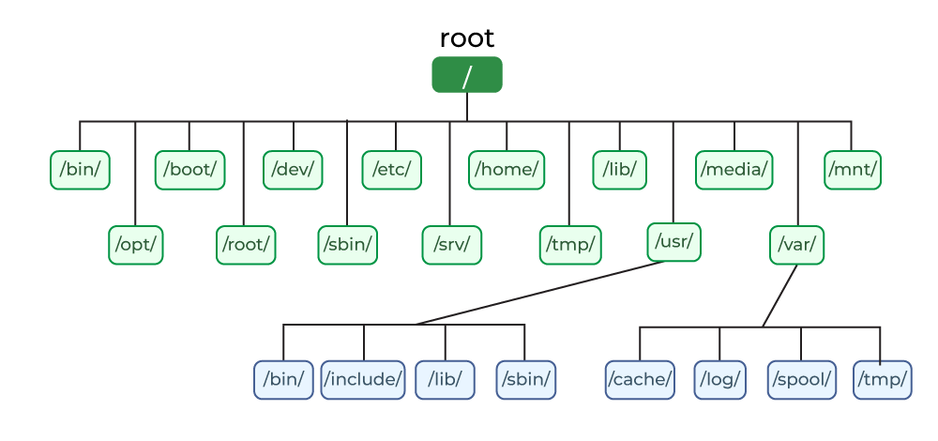
File System Structure

Slide 34
Inode
Each file has an inode (index node), identified by a number. A directory maps filename → inode number.
Inode Contents
File type (regular, directory, socket, etc.)
Owner UID, Group GID
Permissions (read, write, execute for owner/group/others)
File size
Number of links (hard links)
Timestamps:
atime (last access)
mtime (last modification)
ctime (last status change)
Pointers to data blocks:
Direct pointers: point to actual data blocks.
Indirect pointers: point to blocks that store addresses of data blocks.
Double indirect: two-level pointers.
Triple indirect: three-level pointers.
This allows UNIX files to grow dynamically.
An inode is a data structure that stores metadata about a file (not the file name).
Each file, directory, or special object has exactly one inode.
A filename → maps to an inode number → inode points to file’s data blocks
Example:
$ ls -li
1050 -rw-r--r-- 1 user user 20480 Sep 15 file.txt

Slide 35
Directory Implementation
A directory is just a file containing a list of:
filename → inode number
Example
File: "notes.txt" → Inode: 1502
File: "report.pdf" → Inode: 1503
Dir : "docs/" → Inode: 1504
To access a file:
Search directory for filename.
Get inode number.
Access inode → follow pointers → get data blocks.
Every directory contains:
. → points to the directory itself
.. → points to the parent directory
Example (ls -lai):
1001 drwxr-xr-x 2 user user 4096 Sep 15 .
1000 drwxr-xr-x 5 user user 4096 Sep 15 ..
1002 -rw-r--r-- 1 user user 6 Sep 15 file1.txt

Slide 36
System Calls
These allow programs to interact with the file system.
Basic File Operations
open()
Opens file and returns file descriptor (int).
Example:
int fd = open("file.txt", O_RDONLY);
2. read()
Reads from file into buffer.
Example:
read(fd, buffer, 100);
3. write()
Writes buffer contents to file.
Example:
write(fd, buffer, size);
4. close()
Closes an open file descriptor.
5.stat()
Retrieves metadata from inode.
Example:
struct stat st;
stat("file.txt", &st);
printf("File size: %ld\n", st.st_size);

Slide 37
Hard vs Soft Links
Both are ways of referring to a file, but they differ.
Hard Link
Hard Link
A hard link is essentially another directory entry pointing to the same inode as the original file.
Since both entries point to the same inode → they share the same data blocks.
Properties:
Same inode number for all hard-linked files.
Deleting one filename does not delete the data as long as at least one hard link remains.
File permissions/ownership are shared (since inode is shared).
Cannot link directories (to avoid loops).
Cannot span across different file systems (since inode numbers are local to a filesystem).
$ echo "hello" > file1
$ ln file1 file2 # create hard link
$ ls -li
12345 -rw-r--r-- 2 user user 6 Sep 15 file1
12345 -rw-r--r-- 2 user user 6 Sep 15 file2
Both file1 and file2 have the same inode number (12345).
Link count = 2 (because two directory entries point to same inode).
If file1 is deleted, data remains accessible via file2.

Slide 38
Hard vs Soft Links
Soft Link (Symbolic Link)
A soft link is a special file that stores the path to another file.
It has its own inode number, different from the target file’s inode.
Think of it as a shortcut/alias.
Properties:
Different inode number from the target.
If the target file is deleted, the symlink becomes dangling (broken link).
Can link to directories.
Can cross different file systems.
Faster to create, but requires one extra lookup (since kernel has to read the symlink → follow path → open real file).
Example:
$ ln -s file1 file3 # create soft link
$ ls -li
12345 -rw-r--r-- 2 user user 6 Sep 15 file1
12345 -rw-r--r-- 2 user user 6 Sep 15 file2
12346 lrwxrwxrwx 1 user user 5 Sep 15 file3 -> file1
file3 has inode 12346 (different).
It stores a reference: file3 -> file1.
If file1 is deleted, file3 is dangling.

Slide 39
Memory Management in UNIX
•Physical vs Virtual memory
•Process Memory Layout: text, data, heap, stack
Paging & Page Tables
Demand Paging in UNIX
•Page Replacement Algorithms: FIFO, LRU, Optimal
• Swapping

Slide 40
Physical vs Virtual Memory
Physical Memory
Actual RAM installed on the system.
Limited in size (e.g., 8 GB).
Directly accessible only by the kernel.
Processes cannot access raw physical memory directly → prevents interference between processes.
Characteristics of Physical Memory
Finite Resource
The total physical memory is fixed (e.g., 16 GB DDR4 RAM).
OS must allocate it among processes efficiently.
Managed in Units (Frames)
Physical memory is divided into frames (fixed-size chunks, e.g., 4 KB each).
These frames are allocated to processes as needed.
Direct Access by Kernel Only
The kernel controls all physical memory access.
User processes cannot directly manipulate physical memory addresses → they see only virtual addresses.
This provides protection: one process cannot overwrite another’s memory.
Mapping via MMU
The CPU’s Memory Management Unit (MMU) translates virtual addresses → physical addresses.
Example: A process wants byte at virtual address 0x00402000. The MMU looks in the page table to find which physical frame it corresponds to (e.g., frame 42 at 0x2A000).

Slide 41
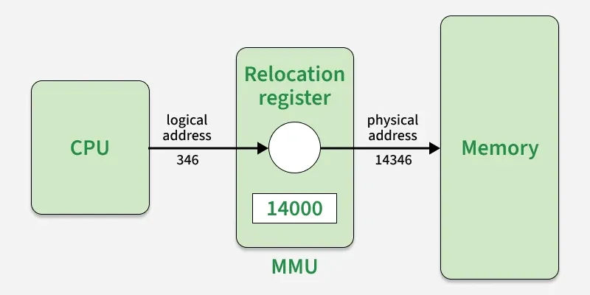
Role of the OS in Managing Physical Memory
Allocation: Assigns frames to processes when they request memory.
Deallocation: Frees frames when processes release or terminate.
Swapping/Paging: If RAM is full, OS may swap/push some frames to disk (swap space).
Protection: Ensures each process accesses only its allocated memory.

Slide 42
Virtual Memory
An abstraction of physical memory provided by the OS + hardware (MMU).
Each process is given its own virtual address space (looks like it has all memory to itself).
Virtual addresses are translated into physical addresses via page tables.
Benefits:
Process isolation (no accidental overwrite).
Allows use of more memory than physically available (via disk swap).
Supports demand paging.
Example:
System has 4 GB RAM.
Process A sees 0x00000000 – 0xFFFFFFFF (4 GB virtual space).
Process B also sees the same range, but mapped to different physical memory pages.

Slide 43
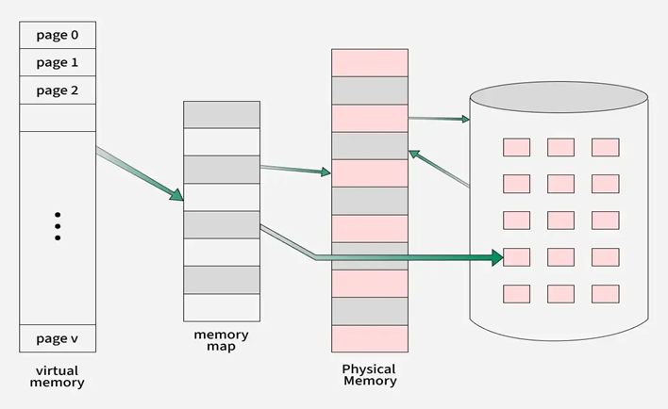
Step 1: Process generates a virtual address
Every instruction that accesses memory (load/store/fetch) uses a virtual address.
Example: 0x00405005.
This address is divided into:
Virtual Page Number (VPN) → identifies the page.
Page Offset → position inside that page.
Step 2: MMU extracts VPN and Offset
The Memory Management Unit (MMU) splits the virtual address:
VPN → used for page table lookup.
Offset → kept aside to append later.
Step 3: Page Table Lookup
MMU checks the process’s page table (kept by OS in memory).
Page Table Entry (PTE) contains:
PFN (Physical Frame Number) → if page is in RAM.
Valid/Invalid bit → indicates whether the page is present in RAM.
Access permissions → read/write/execute.
Other metadata → dirty bit, reference bit, etc.

Slide 44
Step 4A: If Page is in RAM (Valid Entry)
MMU replaces VPN with PFN.
Final physical address = PFN + Offset.
Memory access continues normally.
Step 4B: If Page is NOT in RAM (Invalid Entry → Page Fault)
MMU raises a page fault interrupt to OS.
OS locates the page on disk (swap space or executable).
OS loads the page into a free frame in physical memory.
Page table is updated with the new PFN.
Instruction that caused the fault is restarted.
Step 5: Physical Address is Accessed
The translated physical address is sent to RAM.
Data (read/write) happens at that physical location.

Slide 45
Process Memory Layout
Each process has a structured memory layout in virtual space:
High Address
Stack | (grows down) → function calls, local vars
Heap | (grows up) → dynamic memory (malloc/new)
BSS Segment | → uninitialized globals/static vars
Data Segment | → initialized globals/static vars
Text Segment | → program code (read-only)
Low Address
Text segment: machine instructions (read-only).
Data segment: initialized variables.
BSS segment: uninitialized variables (set to zero).
Heap: grows upward when memory is allocated dynamically.
Stack: grows downward with function calls and local variables

Slide 46
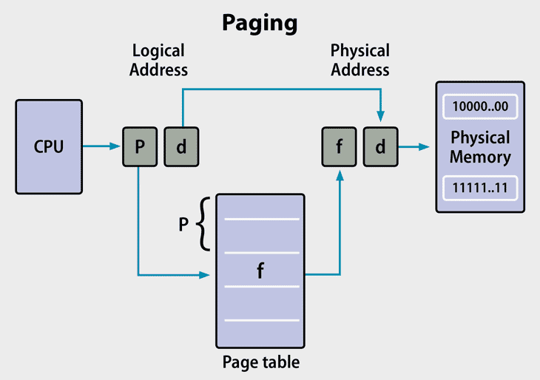
Paging & Page Tables
What is Paging?
Paging is a memory management scheme that eliminates fragmentation and simplifies allocation.
It divides virtual memory and physical memory into fixed-size blocks:
Pages → fixed-size blocks of virtual memory.
Frames → fixed-size blocks of physical memory.
Page size = Frame size (e.g., 4 KB).
Each virtual page is mapped to a physical frame using a page table.
How Paging Works
Process generates a virtual address.
Virtual Address = Page Number + Offset.
OS keeps a Page Table to map Virtual Page Numbers (VPN) → Physical Frame Numbers (PFN).
The MMU (Memory Management Unit) uses the Page Table to translate virtual → physical addresses

Slide 47
Paging & Page Tables
Paging
Divides virtual memory into fixed-size pages (e.g., 4 KB).
Physical memory is divided into frames (same size as pages).
Each virtual page is mapped to a physical frame using a page table.
Page Table
Maintained by OS for each process.
Maps virtual page number → physical frame number.
Example:
If page is not in memory, a page fault occurs → OS brings it from disk (swap).
Virtual Page | Physical Frame
0 | 5
1 | 9
2 | 2
3 | 7

Slide 48
What is a Page Table?
A Page Table is a data structure maintained by the OS to map a process’s Virtual Pages to Physical Frames in RAM.
Every process has its own page table.
The MMU (Memory Management Unit) uses the page table to translate virtual addresses → physical addresses.
Structure of a Page Table Entry (PTE)
Each Page Table Entry (PTE) holds information about one virtual page:
Field | Meaning
PFN (Physical Frame Number) | Which physical frame this page is stored in.
Valid/Invalid Bit | 1 if page is in RAM, 0 if not (page fault).
Protection Bits | Permissions (Read/Write/Execute).
Dirty Bit | 1 if page has been modified, else 0 (important for writing back to disk).
Referenced Bit | Used for page replacement algorithms (shows if page was recently used).
Caching/Control Bits | Hardware-level optimizations.

Slide 49
Types of Page Tables
Because programs can use huge address spaces, page tables can get very large. Different designs exist:
(a) Single-Level Page Table
Simple array mapping VPN → PFN.
Works well for small address spaces.
Problem: Huge memory overhead for large address spaces (e.g., 64-bit).
b) Multi-Level Page Tables (Hierarchical)
Breaks the page table into levels (2, 3, or 4 levels).
Only allocates entries for regions actually used by the process.
Common in modern 64-bit systems.
Example (2-level):
Virtual Address = [Directory Index | Table Index | Offset].
Directory points to a page table, which points to frames.
(c)Inverted Page Table
Instead of one entry per virtual page, it has one entry per physical frame.
Each entry tells which (process, virtual page) is stored in that frame.
Saves memory for very large address spaces.
(d) Hashed / TLB-assisted Page Tables
Use hashing or Translation Lookaside Buffer (TLB) (a cache for page table entries).
Speeds up translation since page table lookups are frequent.

Slide 50
Demand Paging in UNIX
Pages are not loaded into RAM until needed (lazy loading).
When a process tries to access a page that is not in memory:
Page Fault occurs.
OS checks if the page is valid.
If valid, it loads the page from disk (swap area or executable file) into RAM.
Updates page table.
Restarts instruction.
Advantages:
Efficient memory use (only needed pages loaded).
Supports large programs that don’t fit entirely in RAM.

Slide 51
What is Demand Paging?
Demand Paging = a memory management scheme where pages are loaded into physical memory (RAM) only when they are needed (on demand).
Unlike pre-paging, which loads many pages in advance, demand paging is lazy loading.
Used in UNIX/Linux to run programs larger than physical memory.
Benefit: Saves RAM and reduces startup time (only necessary pages are brought in).
How Demand Paging Works
Process starts execution → only a few essential pages (like code and stack) are loaded.
If process references a page not in RAM:
A page fault occurs.
The OS traps to the kernel and checks if the reference is valid.
If valid → OS loads the page from disk (swap space or executable file).
Updates page table (mark as present, valid).
Resumes process.
If invalid (illegal address) → process receives segmentation fault (SIGSEGV).

Slide 52
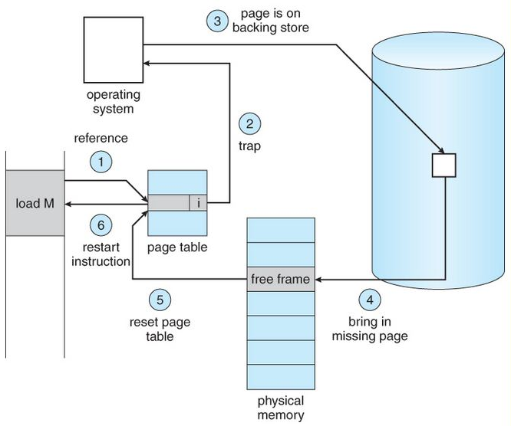
Page Fault Handling Steps in UNIX
CPU generates a virtual address.
MMU looks up page table → entry marked “invalid” (page not in RAM).
Hardware raises page fault interrupt.
OS checks:
Is the memory reference valid?
❌ No → kill process (seg fault).
✅ Yes → continue.
OS finds a free frame in RAM.
If no free frame → use a page replacement algorithm (FIFO, LRU, Optimal).
OS loads page from disk (swap area or file system) into RAM.
Updates page table entry → mark page as valid + frame number.
Restart instruction that caused the fault.

Slide 53
Page Replacement Algorithms
When memory is full and a new page is needed, the OS must evict a page.
(a) FIFO (First-In-First-Out)
The oldest page in memory is replaced first.
Easy but may evict frequently used pages.
(b) LRU (Least Recently Used)
Replace the page that hasn’t been used for the longest time.
Good performance but costly to implement (requires tracking usage).
(c) Optimal (MIN)
Replace the page that will not be used for the longest time in the future.
Not practical (requires future knowledge) → used as a benchmark.
Example (3 frames, reference string: 7, 0, 1, 2, 0, 3, 0, 4):
FIFO → many page faults.
LRU → fewer page faults.
Optimal → minimum possible faults.

Slide 54
Swapping
What is Swapping?
Swapping is a memory management technique where entire processes or pages are temporarily moved between RAM and disk (swap space) to free up physical memory.
It is used when RAM is full and the system needs space for active processes.
In UNIX/Linux, swapping usually refers to paging out individual pages to disk (not entire processes, as in older systems).
Why Swapping is Needed
Physical memory (RAM) is limited.
Many processes may be active at once.
To keep the system responsive, the kernel moves inactive or less-used pages to swap space on disk.
When needed again, those pages are swapped back into RAM.

Slide 55
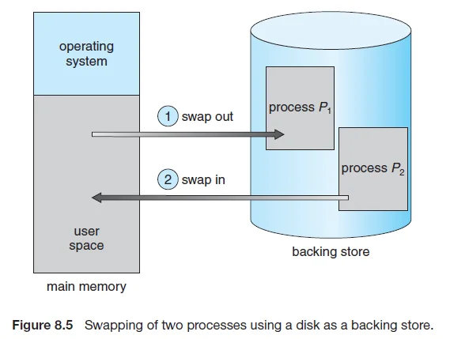
Swapping Process in UNIX/Linux
Step 1: Memory Pressure
OS detects low free memory.
Step 2: Select Pages to Swap Out
Page replacement algorithm (e.g., LRU, FIFO, Clock) decides which pages are least recently used.
Step 3: Write Pages to Swap Space
The selected pages are written to a special area on disk called swap space (partition or swap file).
Their page table entries are marked as not present.
Step 4: Free Frames
The physical frames used by those pages are freed for use by other processes.
Step 5: Page Fault on Access
If a swapped-out page is accessed again → page fault occurs.
OS retrieves the page from swap space back into RAM.

Slide 56
UNIX Performance & Optimization
• Factors: CPU, I/O, Memory, File System
• Monitoring Tools: top, vmstat, iostat, sar

Slide 57
UNIX Performance & Optimization factors
CPU (Central Processing Unit) Role: Executes instructions of processes. Performance indicators: Load Average (from uptime or top): shows average runnable processes. If load > number of cores → CPU bottleneck. User vs System Time (top → %us vs %sy): User time = executing application code. System time = executing kernel code. Context Switching: frequent switches slow down performance. Bottlenecks: Too many CPU-bound processes (e.g., compilation, video rendering). Poor scheduling (high-priority jobs starving others). Optimization: Use nice / renice to adjust priorities. Pin processes to cores with taskset. Optimize algorithms to reduce CPU cycles. | I/O (Input/Output) Role: Handles disk + network operations. Why slower than CPU/RAM: mechanical disks (seek/rotation), network latency. Performance indicators: iostat: %util (disk busy time), await (I/O wait time). vmstat: shows blocked processes (b). Bottlenecks: Too many read/write requests. Disk fragmentation (old FS). Slow devices (HDD vs SSD). High network latency or packet drops. Optimization: Use SSDs or RAID. Increase I/O scheduler efficiency (deadline, noop for SSDs). Use async I/O or caching.

Slide 58
UNIX Performance & Optimization factors
Memory Role: Stores data/code for fast access. Performance indicators: free / vmstat: available memory. si/so (swap in/out) in vmstat: high values → memory pressure. Page faults (too frequent → slow performance). Bottlenecks: Running many apps exceeding RAM. Poor paging → high disk swapping. Cache thrashing. Optimization: Add more RAM. Adjust vm.swappiness. Use HugePages for large memory apps (DBs). Optimize application memory usage. | File System Role: Organizes data in files/directories. Performance indicators: Metadata operations (inode lookups). Journaling overhead. File access latency. Bottlenecks: Frequent metadata updates (e.g., updating access times). Slow FS recovery after crash. Small file fragmentation. Optimization: Use journaling FS (ext4, XFS, ZFS). Mount with noatime to avoid updating access time. Use caching + prefetching. Defragment if needed (on older FS).

Slide 59
Monitoring Tools: top, vmstat, iostat, sar
1. top
Purpose: Real-time view of processes, CPU, and memory usage.
Key Features:
Shows running processes, their PID, CPU%, MEM%, state.
Displays system load average, uptime, task counts.
Usage:
top
top -o %CPU # sort by CPU usage
top -o %MEM # sort by memory usage
Optimization Use: Identify “hog” processes, check if system load > available cores, adjust priorities (renice).
2. vmstat (Virtual Memory Statistics)
Purpose: Summarizes CPU, memory, swap, I/O, and process states.
Usage:
vmstat 2 5 # refresh every 2 sec, show 5 times
Key Fields:
r: processes waiting for CPU.
b: processes blocked (I/O wait).
si/so: swap in/out (high → memory bottleneck).
us/sy/id/wa: CPU breakdown → user, system, idle, I/O wait.
Optimization Use: Detect CPU overloading, memory shortage (swap activity), or I/O bottlenecks (high wa).

Slide 60
Monitoring Tools: top, vmstat, iostat, sar
3. iostat (I/O Statistics)
Purpose: Monitors disk I/O performance.
Usage:
iostat -dx 2
Key Metrics:
r/s, w/s: read/write requests per second.
rkB/s, wkB/s: throughput in KB/sec.
await: average wait time (ms).
%util: % time device is busy (close to 100 = bottleneck).
Optimization Use: Detect slow disks, overloaded storage, need for SSD/RAID, or tuning I/O schedulers
4. sar (System Activity Report)
Purpose: Collects historical performance data for CPU, memory, I/O, network.
Usage Examples:
sar -u 5 5 # CPU usage every 5s, 5 times
sar -r 1 10 # memory usage
sar -d 1 10 # disk activity
sar -n DEV 1 # network statistics
Key Benefit: Unlike top, sar provides long-term trends – useful for capacity planning.
Optimization Use: Detect recurring high CPU/memory load at certain times of day, or analyze system slowdowns after-the-fact

Slide 61
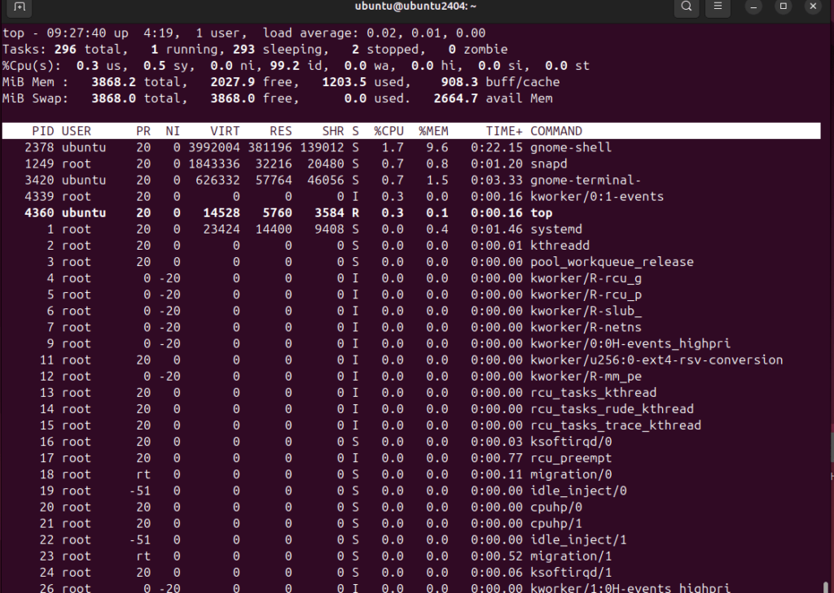
top

Slide 62
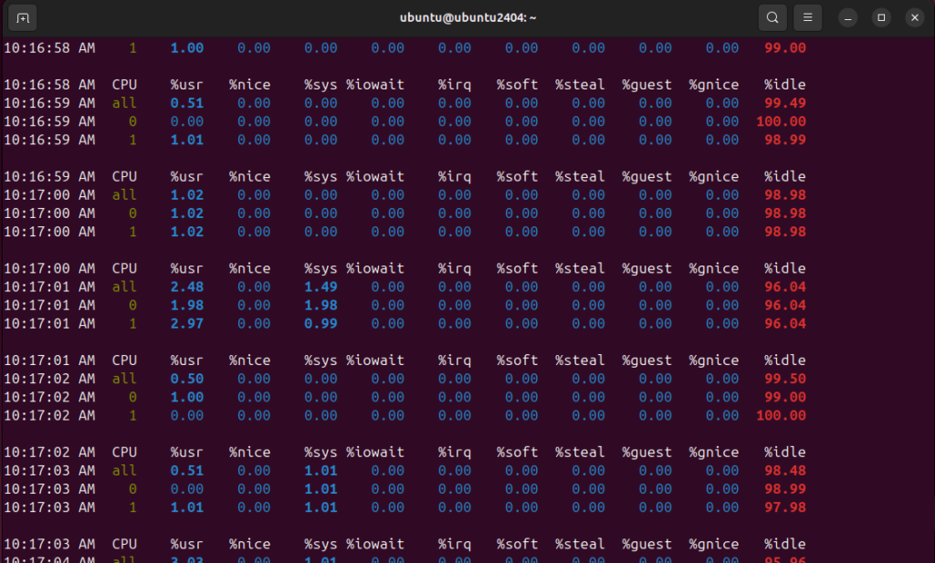
mpstat

Slide 63
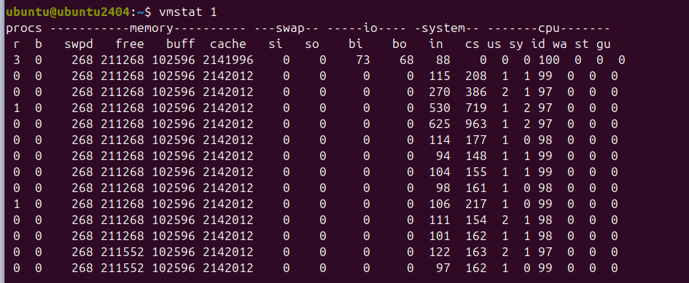
vmstat

Slide 64
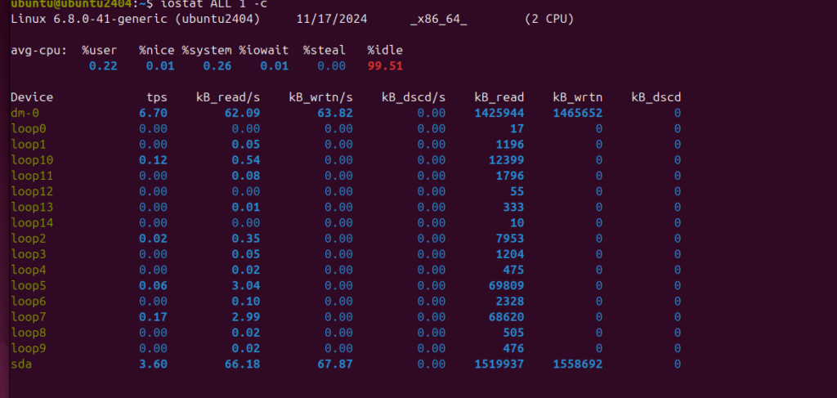
iostat

Slide 65
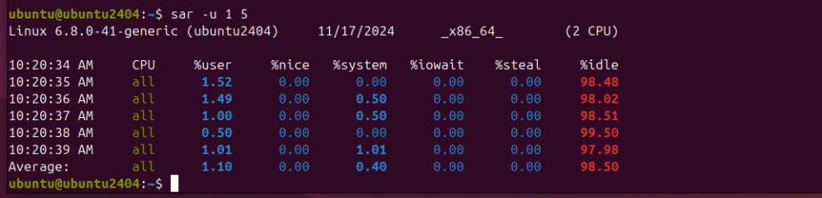
sar

